Slide 1
Grant Writing Basics
for New Researchers
Jim Rankin
Vice Provost for Research and Economic Development
(VPRED)
Notes:
Get settled in, fire up your devices - take home – we want you to be successful

Slide 2
Office of the VPRED
MISSION
Creating a nationally recognized research institution through empowerment, collaboration and innovation.

Slide 3
Model for Growth in a Knowledge-based Economy
Quality of Life
Ideas
Entrepreneurs
Innovation
Industry
University
Arkansas
Economy
Skilled
workforce
$$

Slide 4
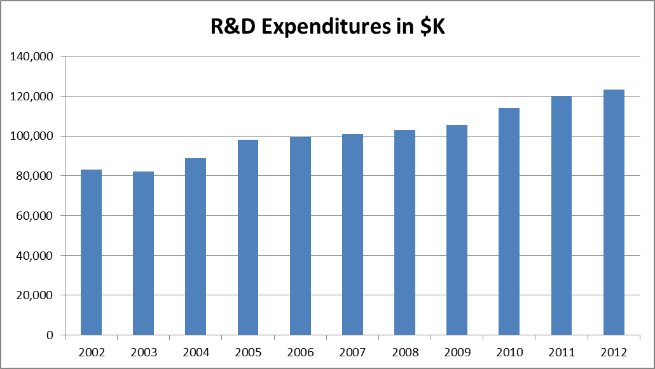
Research Expenditures
R&D Expenditures ($K)

Slide 5
Top American Research Universities - 2012
 | University of Arkansas | Overall Ranking | Public Ranking
Total Research Expenditures (2010) | $104.3M | 136 | 97
Federal Research Expenditures (2010) | $32.7M | 176 | 128
Endowment Assets (2011) | $777.6M | 88 | 30
Annual Giving (2011) | $108.84M | 55 | 31
National Academy Members (2011) | 3 | 109 | 63
Faculty Awards in the Arts, Humanities, Science, Engineering, and Health (2011) | 8 | 78 | 49
Doctorates Granted (2011) | 166 | 102 | 72
Postdoctoral appointees (2010) | 103 | 123 | 83
SAT range (2010) | Not listed | Not listed (191 in 2009) | Not listed (45 in 2009)
If UA had more than $40M in fed exp., we would have tied for #38 public (with Colorado State, Hawaii, Houston, Nebraska, Oregon, South Carolina, and VCU).

Slide 6
Office of the VPRED Organization

Slide 7
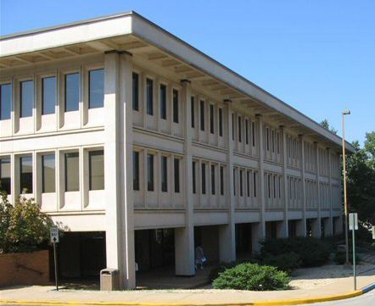
Vice Provost for Research and Economic Development
Vice Provost for Research and Economic Development (Jim Rankin)
Associate Vice Provost for Research and Economic Development (Cindy Sagers, interim)
Research
Economic Development
Centers and Institutes
Research and Sponsored Programs
(TBD - SEARCH)
Research Compliance (Rosemary Ruff)
Technology Ventures
(Jeff Amerine)
Entrepreneurship (Carol Reeves)
UA Technology and Development Foundation (Phil Stafford)
Budget Manager (Amita Patel)
Arkansas Space and Planetary Science (Lin Oliver)
Arkansas Center for Nano Science and Engr. (Greg Salamo)
UA Press (Larry Malley)
High Performance Computing Center (Rick McMullen)
Department and College Centers and Institutes

Slide 8
Vice Provost for Research and Economic Development
Vice Provost for Research and Economic Development (Jim Rankin)
Associate Vice Provost for Research and Economic Development (Cindy Sagers, interim)
Research
Economic Development
Centers and Institutes
Research and Sponsored Programs
(TBD - SEARCH)
Research Compliance (Rosemary Ruff)
Technology Ventures
(Jeff Amerine)
Entrepreneurship (Carol Reeves)
UA Technology and Development Foundation (Phil Stafford)
Budget Manager (Amita Patel)
Arkansas Space and Planetary Science (Lin Oliver)
Arkansas Center for Nano Science and Engr. (Greg Salamo)
UA Press (Larry Malley)
High Performance Computing Center (Rick McMullen)
Department and College Centers and Institutes

Slide 9
Vice Provost for Research and Economic Development
Vice Provost for Research and Economic Development (Jim Rankin)
Associate Vice Provost for Research and Economic Development (Cindy Sagers, interim)
Research
Economic Development
Centers and Institutes
Research and Sponsored Programs
(TBD - SEARCH)
Research Compliance (Rosemary Ruff)
Technology Ventures
(Jeff Amerine)
Entrepreneurship (Carol Reeves)
UA Technology and Development Foundation (Phil Stafford)
Budget Manager (Amita Patel)
Arkansas Space and Planetary Science (Lin Oliver)
Arkansas Center for Nano Science and Engr. (Greg Salamo)
UA Press (Larry Malley)
High Performance Computing Center (Rick McMullen)
Department and College Centers and Institutes

Slide 10
Research Support and Sponsored Programs (RSSP)
Manage all proposal submissions and awards
Work with faculty and sponsoring agencies in proposal submission, award and conflict resolution
Assist with RazorGrant – electronic research administration tool to streamline proposal routing, submission and award

Slide 11
Research Compliance
Provide oversight to researchers to ensure regulation compliance
Compliance committees and functions
Institutional Review Board (IRB) (Human Subjects)
Institutional Animal Care and Use Committee (IACUC)
Export Control
Radiation Safety Committee
Biosafety Committee
Toxic Substances Committee
Research Misconduct

Slide 12
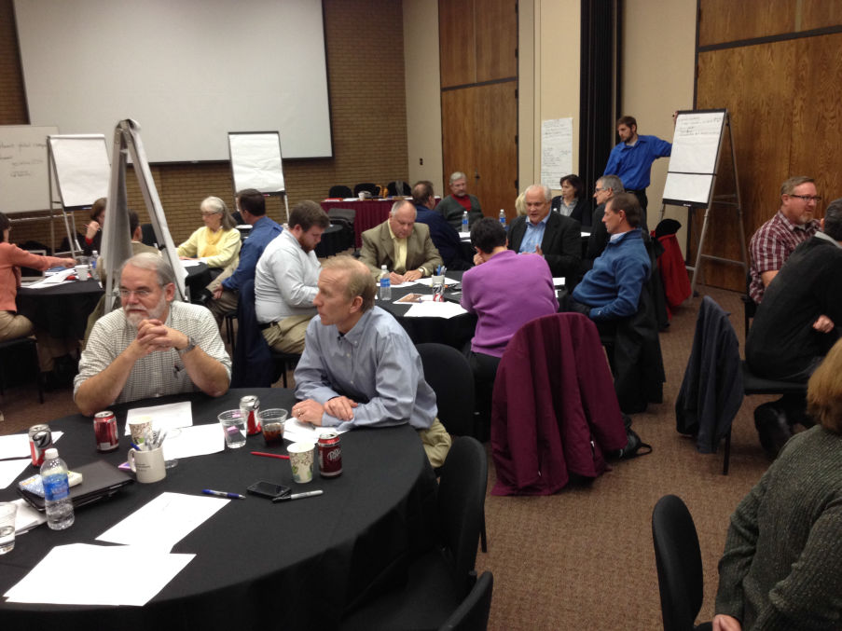
Today’s Workshop
agenda:
Time Activity
1:30 Welcome and introductions (Sagers)
1:45 Finding funding sources (Redfearn)
2:15 Contents of a competitive proposal
(Sagers/Redfearn)
3:15 BREAK
3:30 Tips from a successful researcher
(Lessner)
4:00 Intro to RSSP (Vendetti)
4:15 Making a pitch to a program officer
5:00 Workshop evaluation

Slide 13
Questions?

